Slide 1
AI Peer Review Assistant

Slide 2
Outline
01
02
03
Introduction
Tools & Technologies
Methodology
04
05
06
07
Sample Outputs
Challenges
Future Work
Conclusion

Slide 3
01
Introduction

Slide 4
This project focuses on improving and rewriting specific projects by generating more formal, clear, and polished text.
It corrects grammatical errors, adjusts and refines the wording, and produces new, enhanced sentences when needed.
The system also analyzes the topic instructions to extract positive and negative aspects, helping to guide the direction and tone of the writing.
Additionally, it ensures that the output sounds more professional and fits academic or formal standards. While the current version already offers strong improvements, future work will focus on integrating more specialized models to achieve even higher writing quality.

Slide 5
02
Tools & Technologies

Slide 6
(a) BERT (Bidirectional Encoder Representations from Transformers)
BERT is a deep learning model developed by Google designed to understand the meaning and context of words in a text. In this project, BERT is used to carefully analyze different sections of academic papers. It helps in detecting common weaknesses, such as flaws in the methodology, unclear research questions, or missing experimental details. By using BERT, the system can better understand the structure and content of research papers and pinpoint areas that may be criticized by human reviewers.
(b) T5 (Text-to-Text Transfer Transformer)
T5 is a powerful language model developed by Google that treats every language problem as a text-to-text task. In this project, T5 is used to generate constructive feedback for researchers. After BERT identifies weaknesses, T5 provides detailed suggestions and editing tips in a human-like and academic tone. This helps researchers receive actionable advice that improves the quality of their writing before submitting their work to conferences or journals.

Slide 7
(c) Dataset
The project uses peer review data from OpenReview.net, particularly from the International Conference on Learning Representations (ICLR). This dataset includes thousands of papers and their corresponding reviewer comments. It provides real examples of critiques, suggestions, and acceptance/rejection decisions. Training on real peer review data allows the AI models to learn how reviewers typically assess scientific work and the kinds of improvements they expect.
(d) Hugging Face Transformers
We use Hugging Face to easily access pre-trained models like BERT and T5 and fine-tune them on our peer review dataset.
(e) Streamlit
Used to build the web app interface.

Slide 8
(f) NLTK (Natural Language Toolkit)
For preprocessing the text before feeding it into models:
Punkt:Tokenizes (splits) text into sentences or words.
Stopwords: Removes common, non-important words to focus only on meaningful text.
(g) Pyngrok
Creates a secure internet tunnel to access local apps like Streamlit without cloud deployment.
Provides authentication and HTTPS encryption for safe, temporary access.
Simplifies development, testing, and sharing.

Slide 9
03
Methodology

Slide 10
Dataset Collection : The dataset for this project was collected from OpenReview.net, specifically focusing on peer review data from the International Conference on Learning Representations (ICLR). It included sections from research papers—such as abstracts, introductions, and methodologies—along with reviewer comments and scores. Only papers with detailed feedback were selected to ensure high-quality training data. This dataset provided a strong foundation for teaching the AI models how to detect weaknesses in research papers and suggest meaningful improvements.
Data Preprocessing : Preprocessing was carried out to prepare the collected data for model training. This involved cleaning the text by removing unnecessary symbols, formatting inconsistencies, and irrelevant content. Paper sections and their corresponding reviewer comments were carefully separated. The cleaned text was then tokenized to meet the input requirements of the BERT and T5 models. Finally, the data was divided into training, validation, and testing sets to ensure proper training and evaluation of the models.

Slide 11
Text Classification with BERT : The BERT model was used to classify different sections of research papers based on their likelihood of receiving critiques from reviewers. BERT was fine-tuned on labeled examples where sections were matched to specific types of reviewer feedback. During training, the model learned to identify weaknesses such as unclear methodologies, flawed experimental designs, and missing references. This classification step allowed the system to predict which parts of a paper were most likely to require improvements.
Text Generation with T5 and GPT-2 : After identifying weaknesses using BERT, the T5 model was employed to generate constructive feedback. Problematic sections were passed as input to T5, along with prompts encouraging improvement suggestions. Fine-tuned on peer review examples, T5 generated specific and actionable feedback, such as recommending clearer explanations, stronger experimental validation, or improved organization. Additionally, GPT-2 was leveraged to generate creative suggestions and rewrite sections of the paper, ensuring the feedback was comprehensive and varied. This allowed the system not only to detect issues but also to propose concrete edits to enhance paper quality.

Slide 12
Specialized Models for Each Feature: To achieve the highest level of accuracy, each major feature in the system rewriting, summarization, sentiment analysis, and topic generation was supported by its own dedicated model and dataset. This modular approach ensured that every functionality was handled with a model best suited for its task, resulting in improved precision and reliability. For example, a grammar-focused model was used for rewriting, a summarization model for condensing content, a sentiment analysis model for gauging tone, and a language generation model for topic suggestions. This separation allowed each model to be fine-tuned independently for its specific role, maximizing the overall performance of the system.

Slide 13
04
Sample Outputs

Slide 14
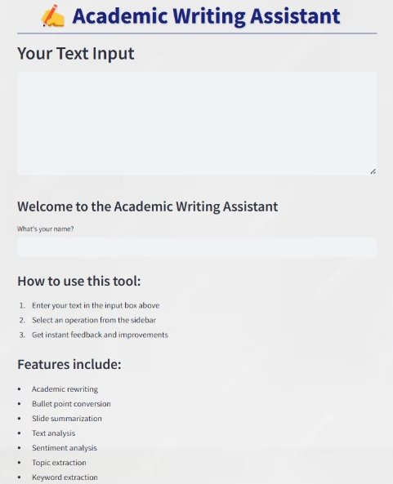
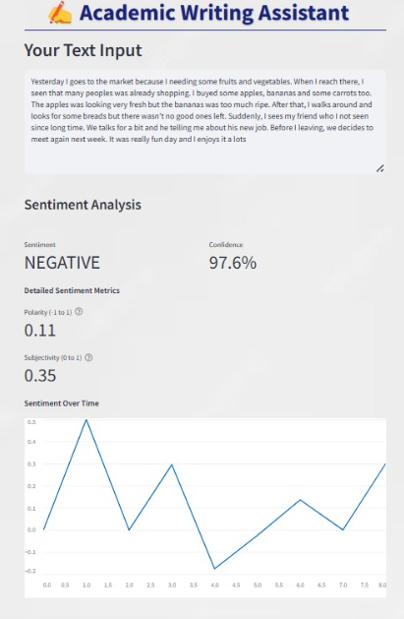
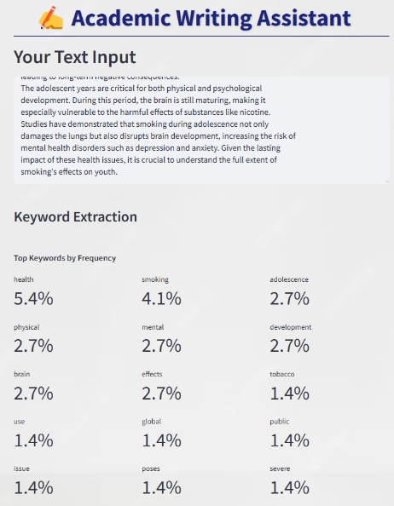
Welcome Page
Sentiment Analysis
Keyword Extraction

Slide 15
05
Challenges

Slide 16
(a) Model Loading Failures
The project uses multiple pre-trained models from the Hugging Face transformers library (T5, BERT). If any of these models fail to load due to network issues, model incompatibilities, or resource limitations, errors may occur, leading to delays or issues in the model's functionality.
(b) Memory Management
Some of the models, especially BERT and T5, are large and can consume significant GPU/CPU memory. This becomes a challenge when the system does not have sufficient resources available. The larger the model, the higher the demand on hardware resources, which may result in slower processing or model loading failures.
(c) Unsupported Inputs for Some Features
Certain features, such as topic extraction or keyword extraction, assume that the input text is in a specific format (plain text). If unsupported content (such as images, tables, or highly unstructured data) is provided as input, these functionalities may not work as expected, impacting the overall accuracy and output of the system.

Slide 17
06
Future Work

Slide 18
Future improvements will focus on integrating more specialized academic models to enhance writing quality.
We plan to add customizable citation styles like APA (American Psychological Association) and MLA (Modern Language Association) to meet diverse academic standards. We also aim to expand multilingual capabilities, introduce real-time collaboration and cloud-saving features, and develop a mobile-friendly version to improve accessibility across devices.
Additionally, we plan to upgrade the system by purchasing more memory to support larger models and faster processing.

Slide 19
07
Conclusion

Slide 20
This project successfully developed an academic writing assistant using Python, which helps automate citation generation, provide writing suggestions, and format papers in APA and MLA styles. By utilizing machine learning and natural language processing, the tool improves writing efficiency and ensures academic accuracy. It demonstrates how AI can support students and researchers in producing high-quality academic content.

